Slide 1
In-Flight Turbulence: Opinions on Acceptable Airplane Behavior
Faith Platz

Slide 2
Data Description
FiveThirtyEight Survey from August 2014
1,040 participants (Random Sample?)
26 questions
Used to publish “41 Percent Of Fliers Think You’re Rude If You Recline Your Seat” (Walt Hickey)
Data available on GitHub
Many questions discussed perceived rudeness of certain behaviors
e.g. “Is it rude to recline your seat on a plane?”
“No, not rude at all”
“Yes, somewhat rude”
“Yes, very rude”

Slide 3
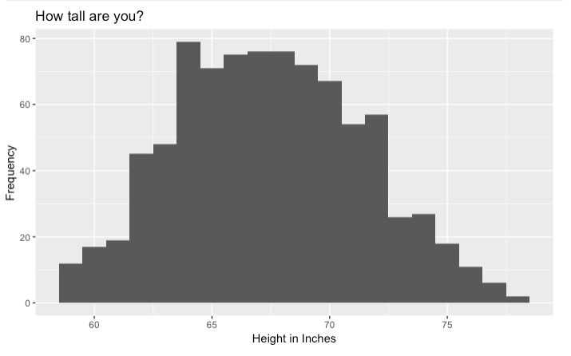
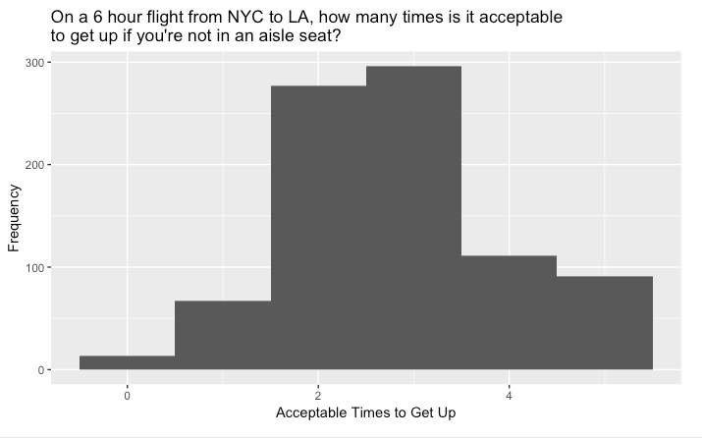
Data Manipulation
All categorical variables, but able to treat two as numeric
”How tall are you?”
“On a 6 hour flight from NYC to LA, how many times is it acceptable to get up if you're not in an aisle seat?”

Slide 4
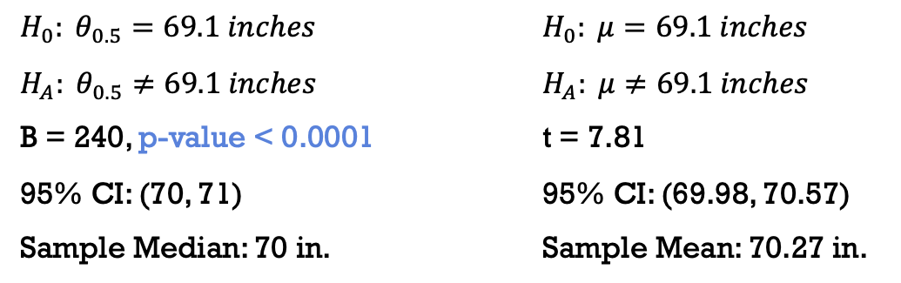

Sign Test: Height (using CDC estimates)
Females
$H_{0}: θ_{0.5}=63.7 inches$ $H_{0}: μ=63.7 inches$
$H_{A}: θ_{0.5}≠63.7 inches$ $H_{A}: μ≠63.7 inches$
B = 310, p-value < 0.0001 t = 8.65
95% CI: (64, 65) 95% CI: (64.59, 65.11)
Sample Median: 65 in. Sample Mean: 64.85 in.
Males
$H_{0}: θ_{0.5}=69.1 inches$ $H_{0}: μ=69.1 inches$
$H_{A}: θ_{0.5}≠69.1 inches$ $H_{A}: μ≠69.1 inches$
B = 240, p-value < 0.0001 t = 7.81
95% CI: (70, 71) 95% CI: (69.98, 70.57)
Sample Median: 70 in. Sample Mean: 70.27 in.
Assume:
Continuous Data
Random Samples
Fryar CD, Gu Q, Ogden CL, Flegal KM. Anthropometric reference data for children and adults: United States, 2011–2014. National Center for Health Statistics. Vital Health Stat 3(39). 2016.

Slide 5
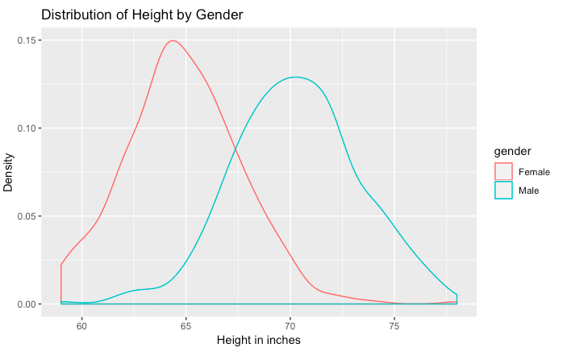
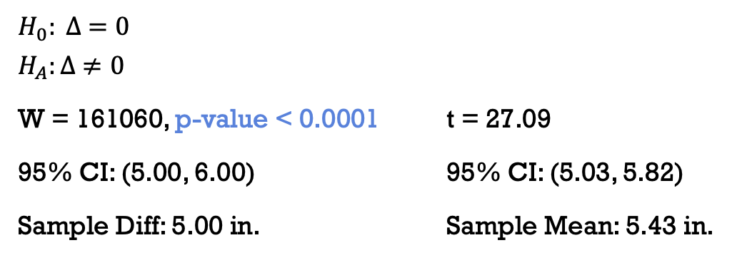
Wilcoxon Rank Sum Test: Height by Gender
$$H_{0}: ∆ =0$$
$$H_{A}:∆ ≠0$$
W = 161060, p-value < 0.0001 t = 27.09
95% CI: (5.00, 6.00) 95% CI: (5.03, 5.82)
Sample Diff: 5.00 in. Sample Mean: 5.43 in.
Assume:
Independent Samples
Equal Shapes

Slide 6
Wilcoxon Rank Sum Test: Height by Reclining Opinions
Does one’s opinion about reclining seats on an airplane have an effect on the passenger’s height?
“Do you ever recline your seat when you fly?”
“Under normal circumstances, does a person who reclines their seat during a flight have any obligation to the person sitting behind them?”
“Is it rude to recline your seat on a plane?”
“Given the opportunity, would you eliminate the possibility of reclining seats on planes entirely?”

Slide 7
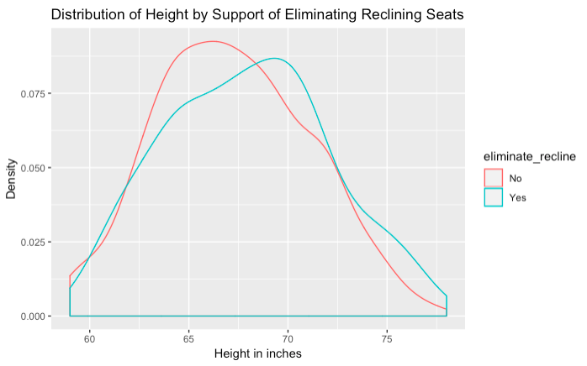
Wilcoxon Rank Sum Test: Height by Reclining Opinions
Subsets | Wilcoxon Rank Sum | Two-Sample t-test
Frequency (“Always” vs. “Never” only) | 0.5165 | 0.5215
Obligation | 0.7446 | 0.8162
Rude? | 0.7442 | 0.5210
Eliminate? | 0.0249 | 0.0187
Those who said they would eliminate the ability for airplane seats to recline tended to be taller than those who said they would not.
Assume:
Independent Samples
Equal Shapes

Slide 8
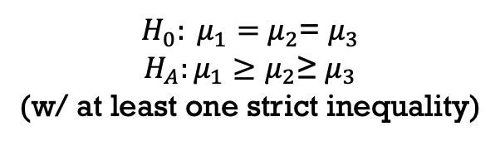
Jonckheere-Terpstra Test: Acceptable times to get up
Rude? | JT (Decreasing) | ANOVA F-test
Speak to Stranger | 0.0015 | < 0.0001
Wake for Bathroom | 0.0005 | < 0.0001
Wake to Walk | 0.0005 | < 0.0001
Bring Baby | 0.029 | 0.0244
Bring Unruly Children | 0.0045 | 0.0021
Recline | 0.001 | 0.0001
Move to Unsold | 0.0005 | 0.0005
Switch (friends) | 0.0005 | 0.0006
Switch (family) | 0.0005 | < 0.0001
For all rudeness questions, as a respondent viewed an action as more rude, the amount of times they thought it was acceptable for someone not in an aisle to get up on a six hour flight decreased.
$H_{0}: μ_{1}=$ $μ_{2}$= $μ_{3}$
$$H_{A}:μ_{1}≥μ_{2}\text{≥ }μ_{3}$$
(w/ at least one strict inequality)

Slide 9
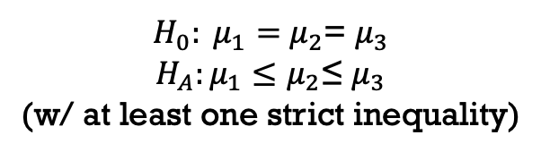
Jonckheere-Terpstra Test: Acceptable times to get up
Variable | JT (Increasing) | ANOVA F-test
Recline Freq. | 0.0055 | 0.0589
Travel Freq. | 0.5705 | 0.206
Education Level | 0.106 | 0.308
Household Income | 0.3885 | 0.972
Generation | 0.727 | 0.835
The only other ordered variable that was significant was recline frequency, suggesting that as a passenger reclines their seat more often, they believe it is acceptable for a non-aisle passenger to get up more times.
$H_{0}: μ_{1}=$ $μ_{2}$= $μ_{3}$
$$H_{A}:μ_{1}≤μ_{2}\text{≤ }μ_{3}$$
(w/ at least one strict inequality)

Slide 10
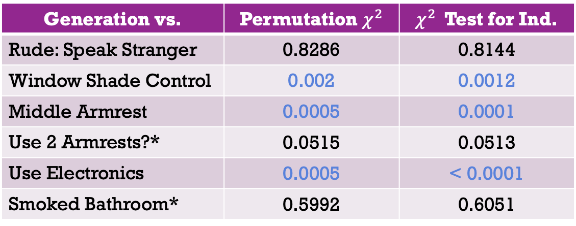

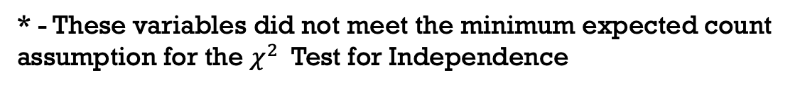
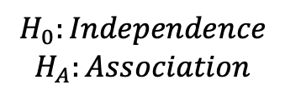
Permutation $χ^{2}$ Test: Generation
Generation vs. | Permutation $χ^{2}$ | $χ^{2}$ Test for Ind.
Rude: Speak Stranger | 0.8286 | 0.8144
Window Shade Control | 0.002 | 0.0012
Middle Armrest | 0.0005 | 0.0001
Use 2 Armrests?* | 0.0515 | 0.0513
Use Electronics | 0.0005 | < 0.0001
Smoked Bathroom* | 0.5992 | 0.6051
* - These variables did not meet the minimum expected count assumption for the $χ^{2}$ Test for Independence
$$H_{0}:Independence$$
$$H_{A}:Association$$

Slide 11
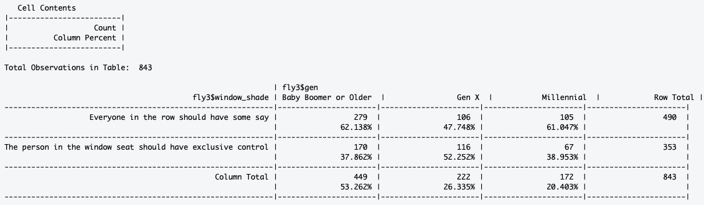
“Who should have control over the window shade?”

Slide 12
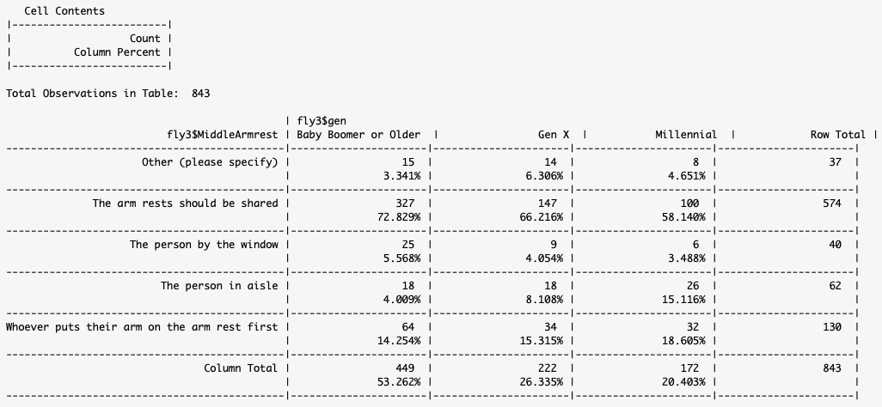
“In a row of two seats, who should get to use the middle arm rest?”

Slide 13
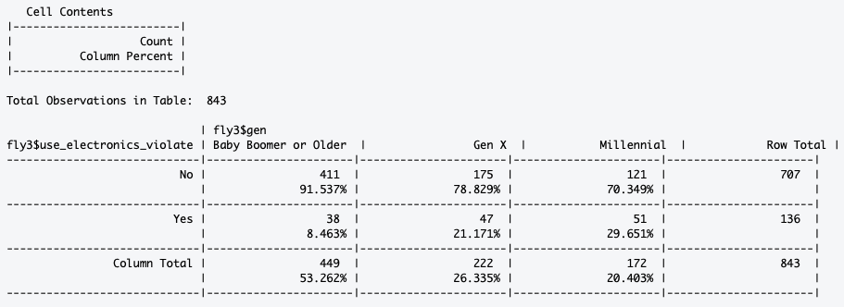
“Have you ever used personal electronics during take off or landing in violation of a flight attendant's direction?”

Slide 14
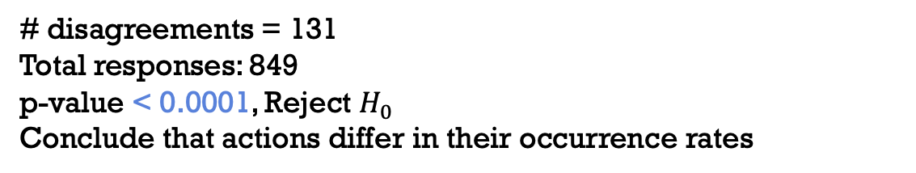
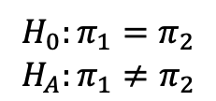

McNemar’s Test: Violations
“Have you ever used personal electronics during take off or landing in violation of a flight attendant's direction?”
 | No | Yes
No | 712 | 130
Yes | 1 | 6
“Have you ever smoked a cigarette in an airplane bathroom when it was against the rules?”
# disagreements = 131
Total responses: 849
p-value < 0.0001, Reject $H_{0}$
Conclude that actions differ in their occurrence rates
$$H_{0}:π_{1}=π_{2}$$
$$H_{A}:π_{1}≠π_{2}$$

Slide 15
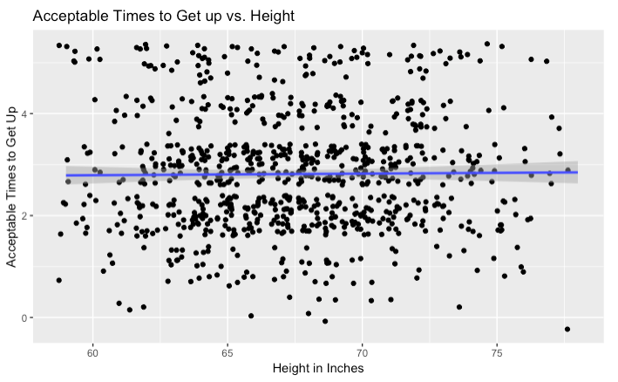
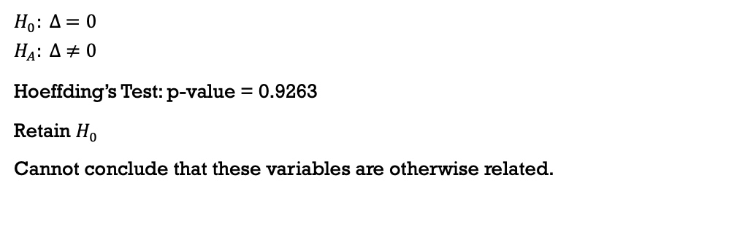
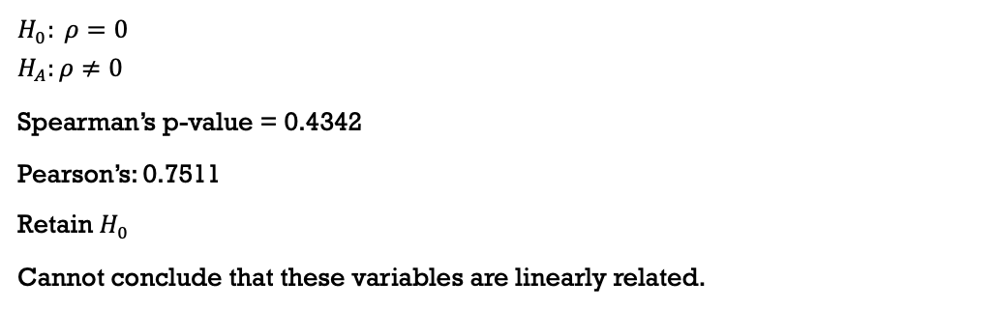
Association: Height & Acceptable times to get up
Linear
$$H_{0}: ρ=0$$
$$H_{A}:ρ≠0$$
Spearman’s p-value = 0.4342
Pearson’s: 0.7511
Retain $H_{0}$
Cannot conclude that these variables are linearly related.
Any dependency
$$H_{0}: ∆ =0$$
$$H_{A}: ∆ ≠0$$
Hoeffding’s Test: p-value = 0.9263
Retain $H_{0}$
Cannot conclude that these variables are otherwise related.
Assume:
Continuous Data
Independent Samples

Slide 16
Summary
Older generations
More egalitarian?
Less rule-breaking?
Getting up out of a non-aisle seat appears to be related to many rude behaviors
Not related strongly with height
The notion of eliminating reclining seats may have more support from the taller population

Slide 17
Questions?

